Slide 1

A Tourism Platform To Encourage Domestic Tourism In Egypt
Supervisor:
Dr.Tahani Allam

Slide 2

Problem Overview

Slide 3
Discover More About
Our Tourism Platform

Slide 4
Responsive For Multiple Devices

Slide 5
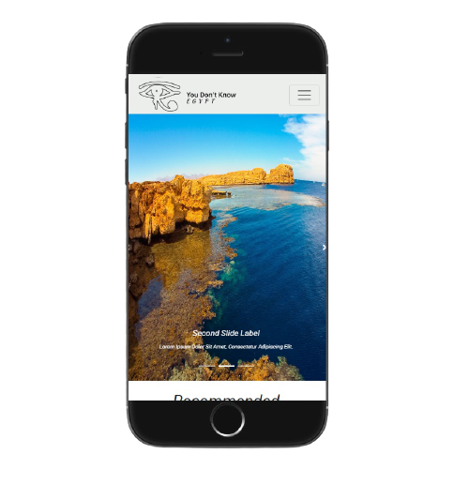
For Mobile

Slide 6
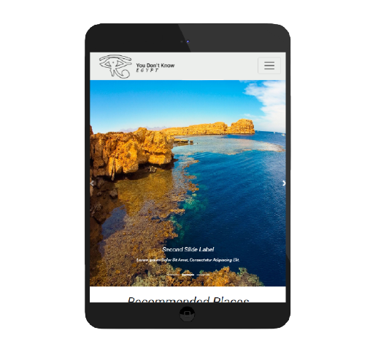
For Tablet

Slide 7
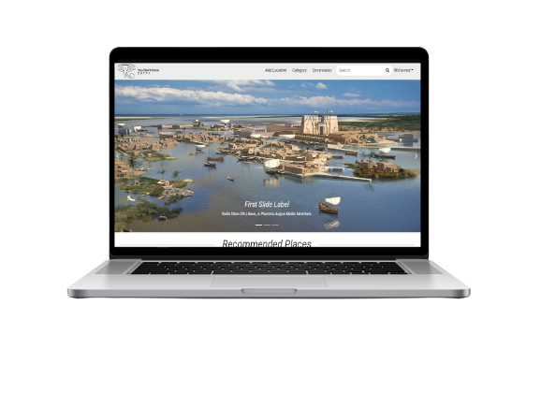
For Desktop

Slide 8
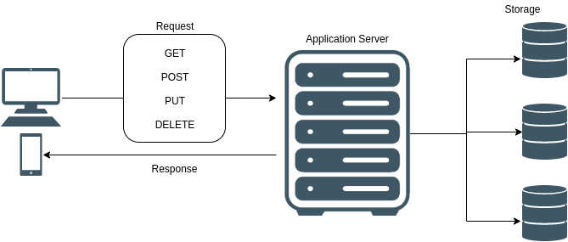
System Overview
GET
POST
PUT
DELETE

Slide 9
Front-End Technologies

Slide 10


Slide 11


Slide 12


Slide 13


Slide 14


Slide 15

Routing

Slide 16
Back-End Technologies

Slide 17


Slide 18


Slide 19


Slide 20

Features

Slide 21

Registration

Slide 22

Login

Slide 23

Add New Location

Slide 24

Search

Slide 25
Contains() Method
O(n) time complexity

Slide 26

All Governorates

Slide 27

Description

Slide 28

Governorate Locations

Slide 29

Hotels

Slide 30

Comments

Slide 31

Recommended Places Mechanism

Slide 32

Optimization

Slide 33

UI Components

Slide 34
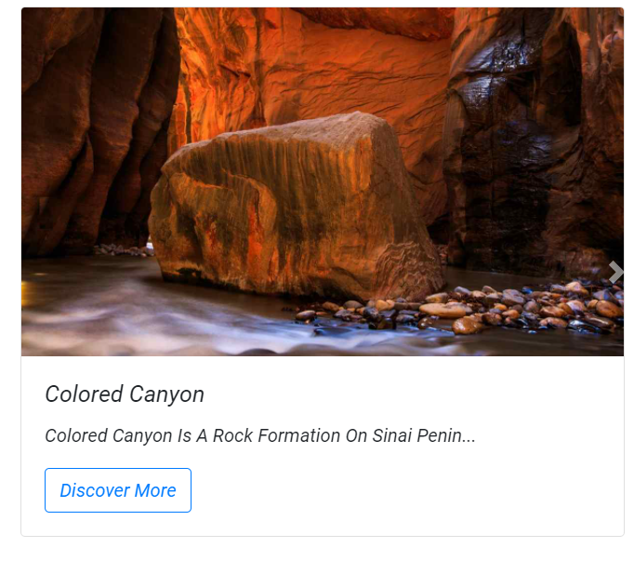
Location Card

Slide 35
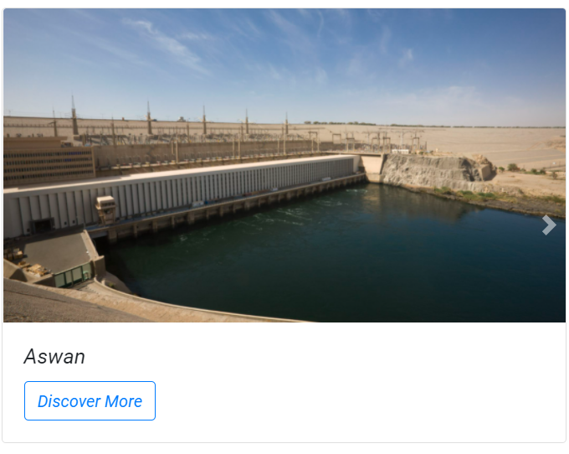
Governorate Card

Slide 36
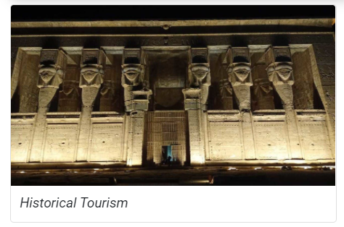
Category Card

Slide 37
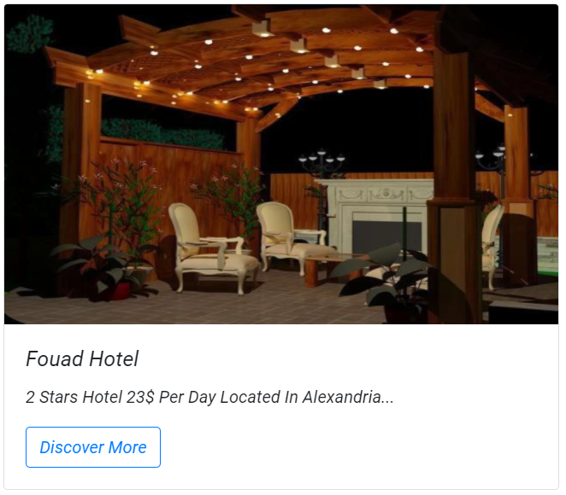
Hotel Card

Slide 38
Home
Add Location
Routing Components
Category
Governorates

Slide 39
Login

Slide 40
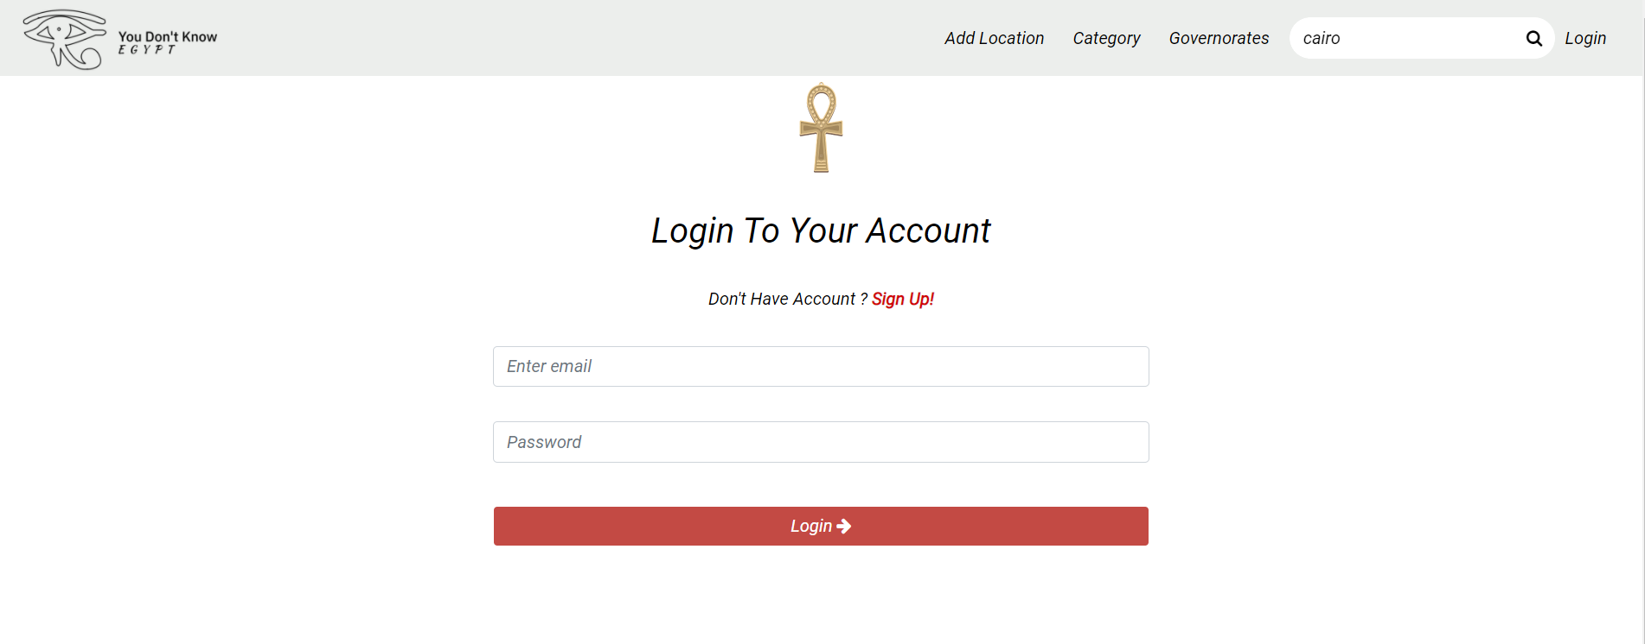

Slide 41
Sign Up

Slide 42
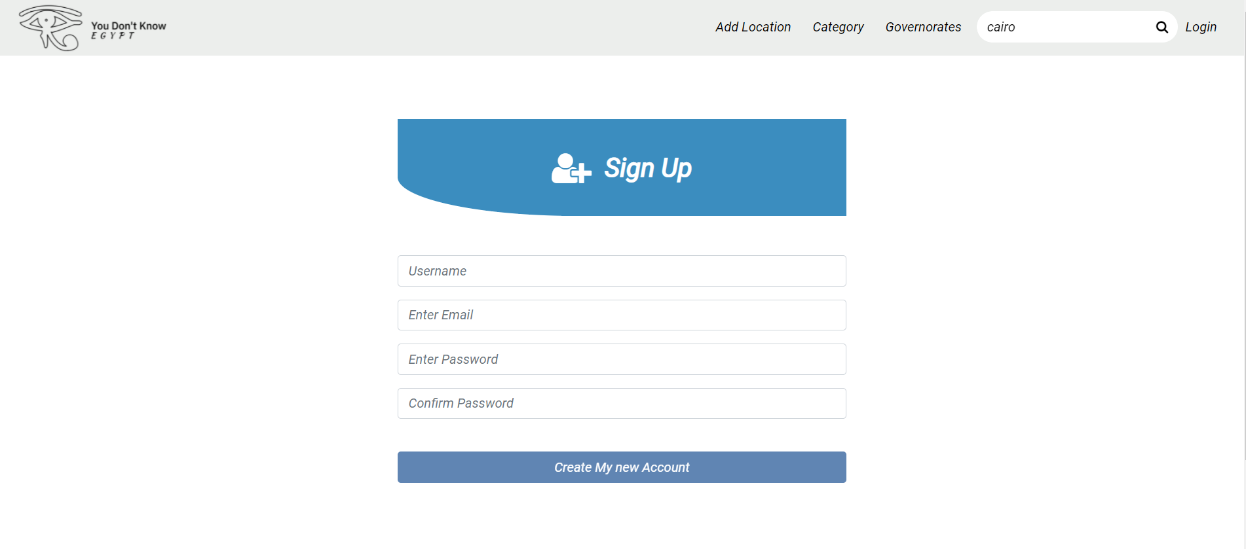

Slide 43
Home Page

Slide 44
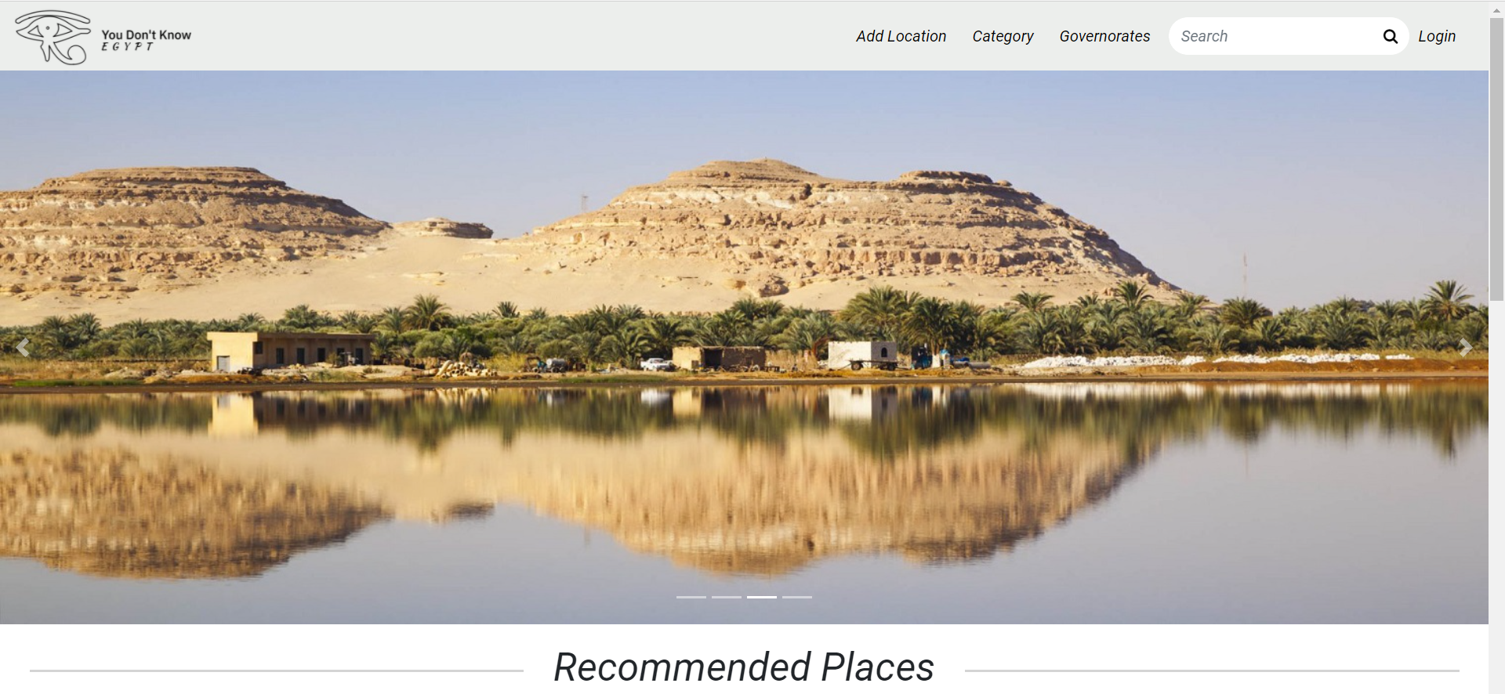

Slide 45
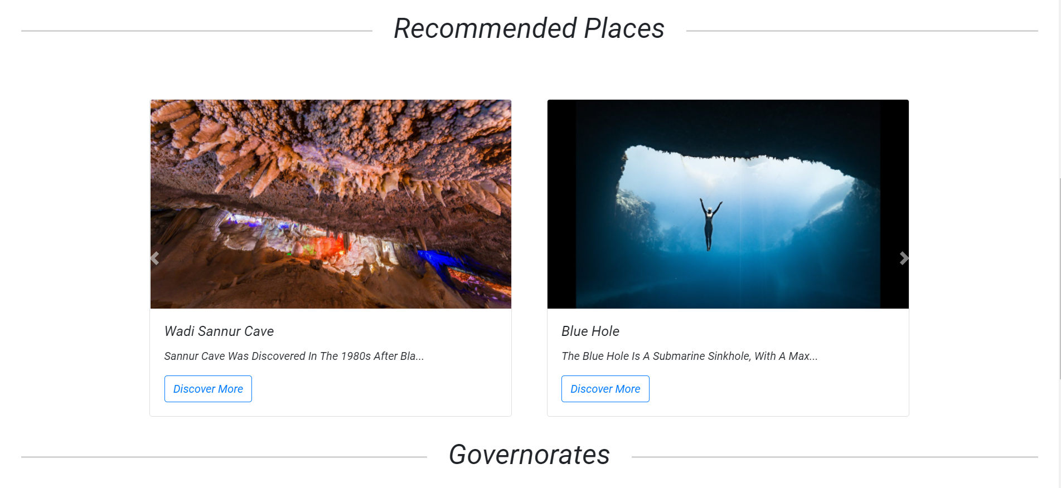

Slide 46
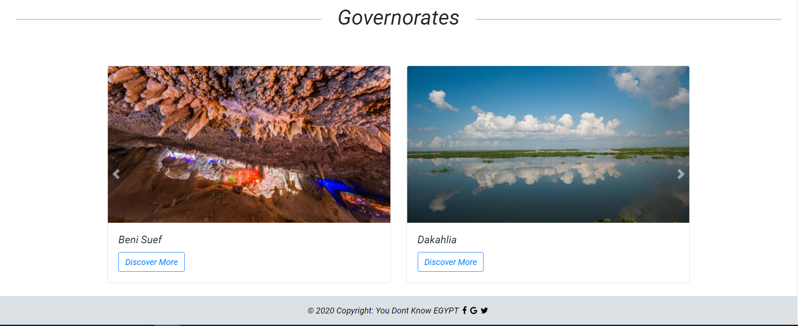

Slide 47
Add Location

Slide 48
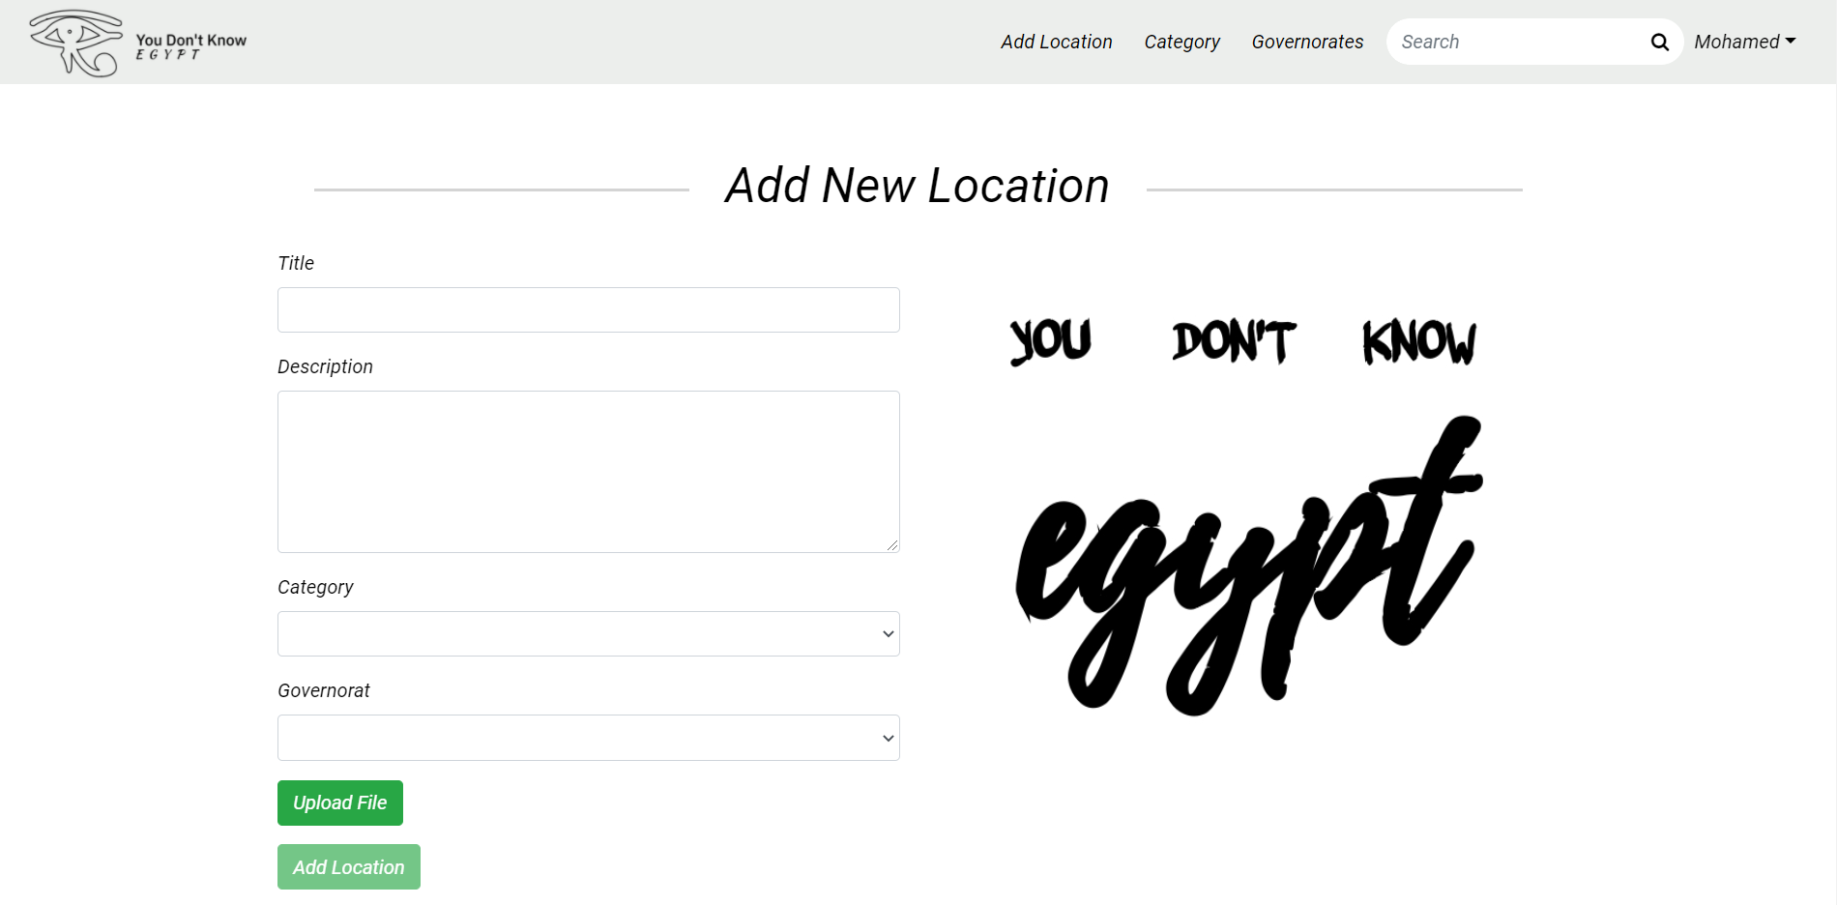

Slide 49
Category

Slide 50
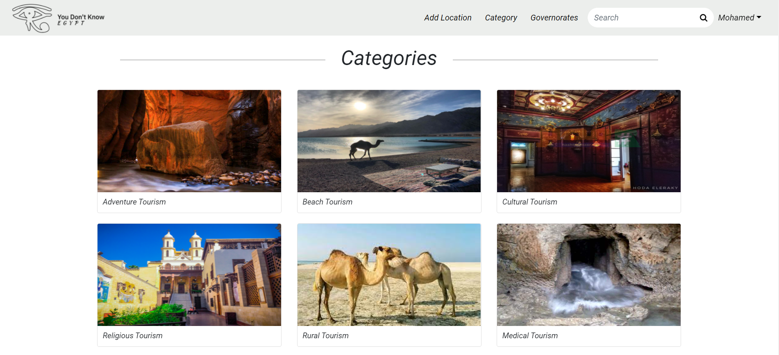

Slide 51
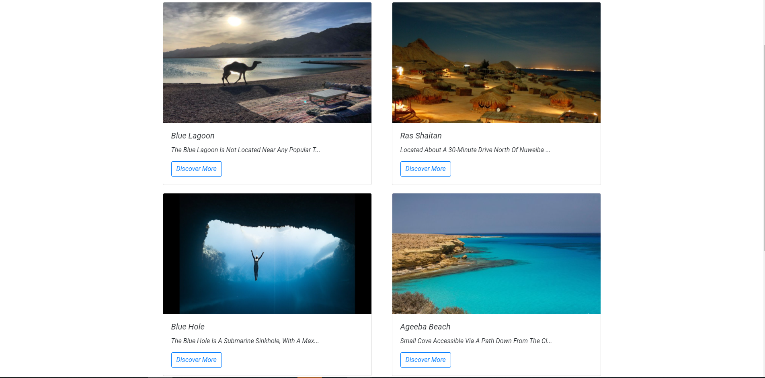

Slide 52
Governorates

Slide 53
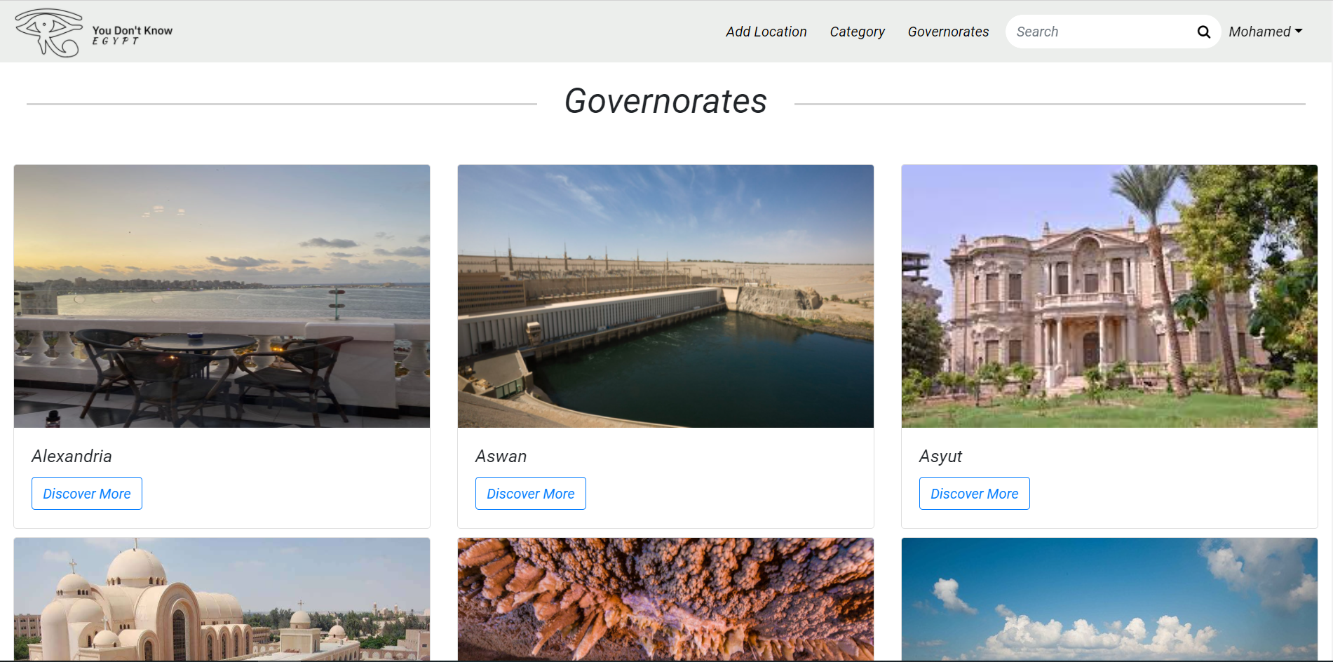

Slide 54
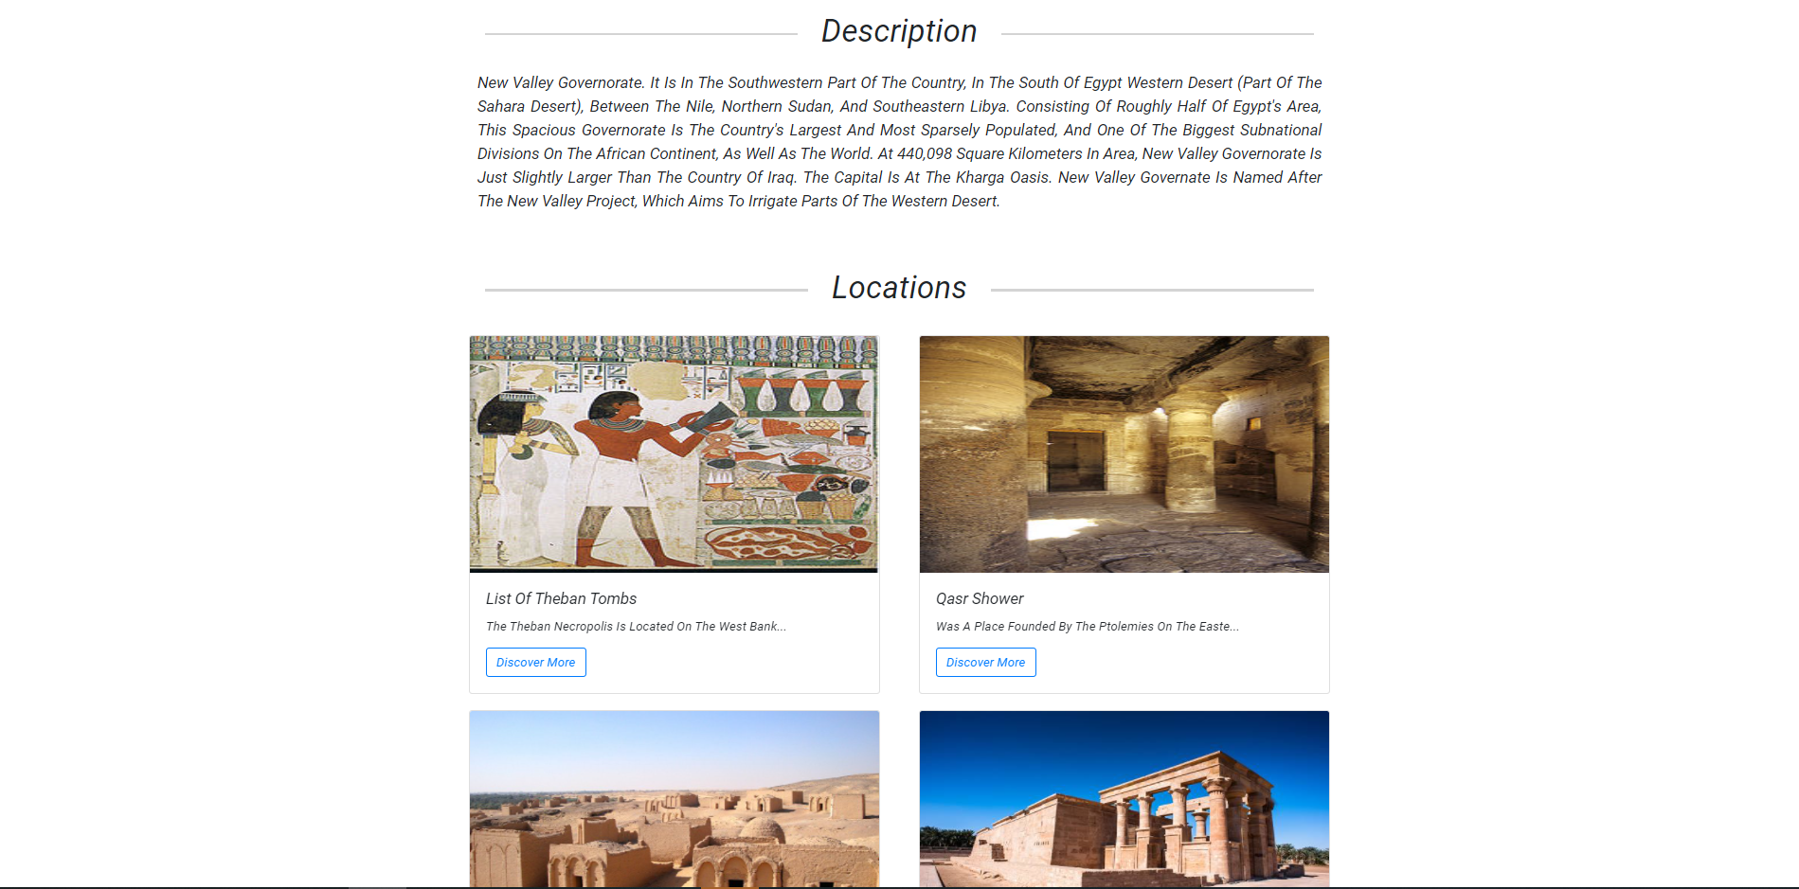

Slide 55
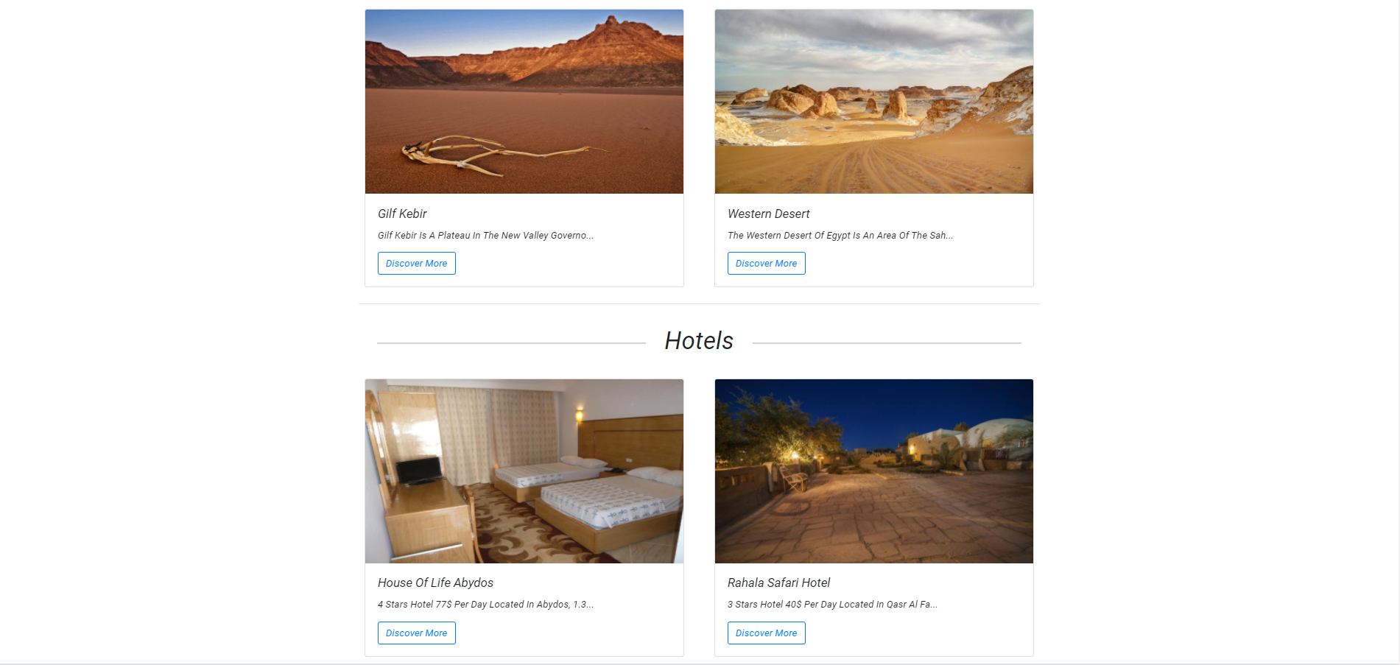

Slide 56
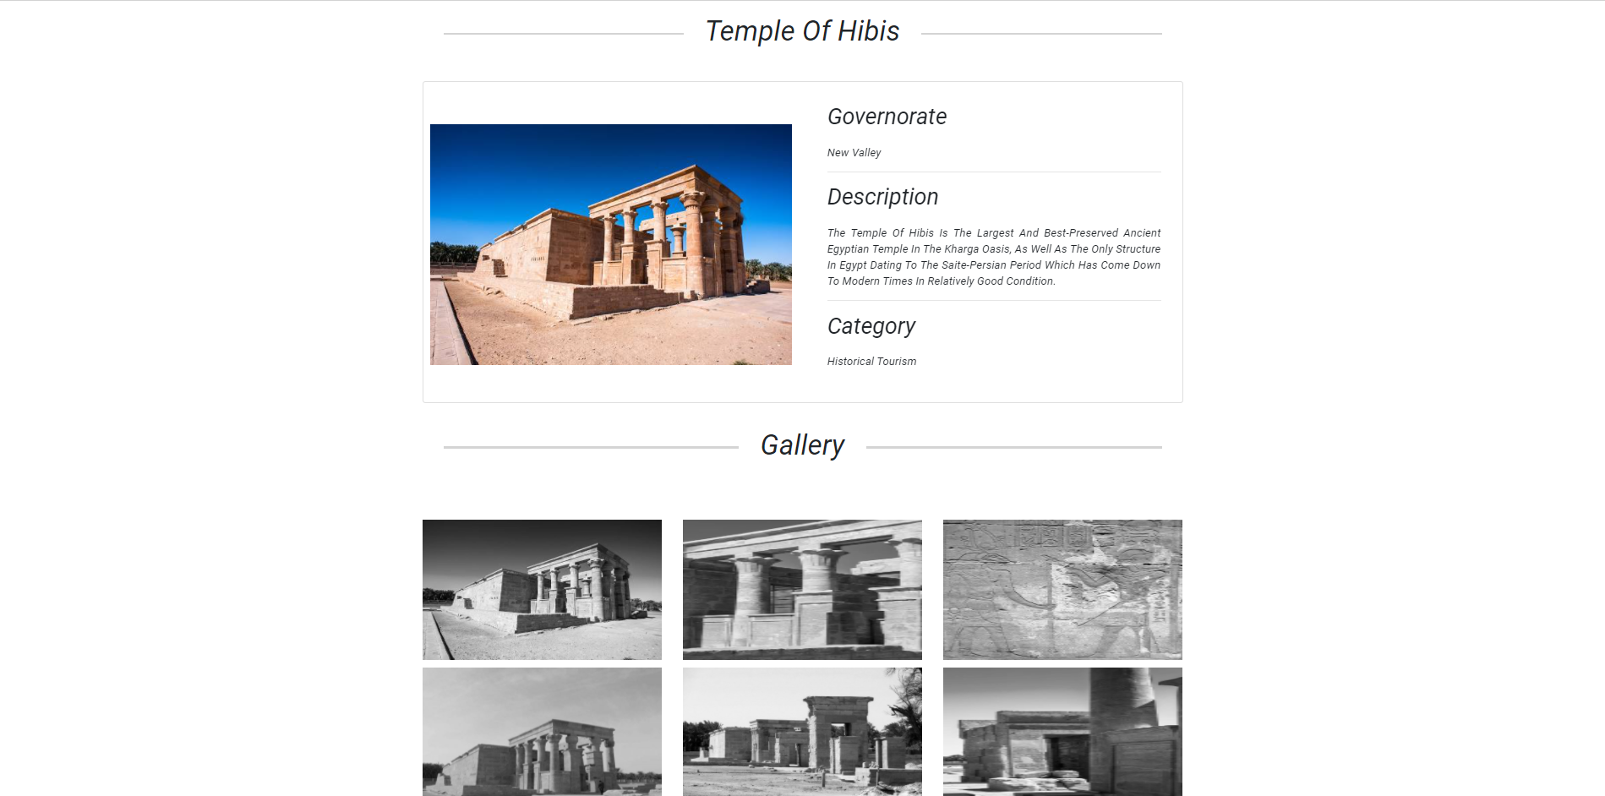

Slide 57
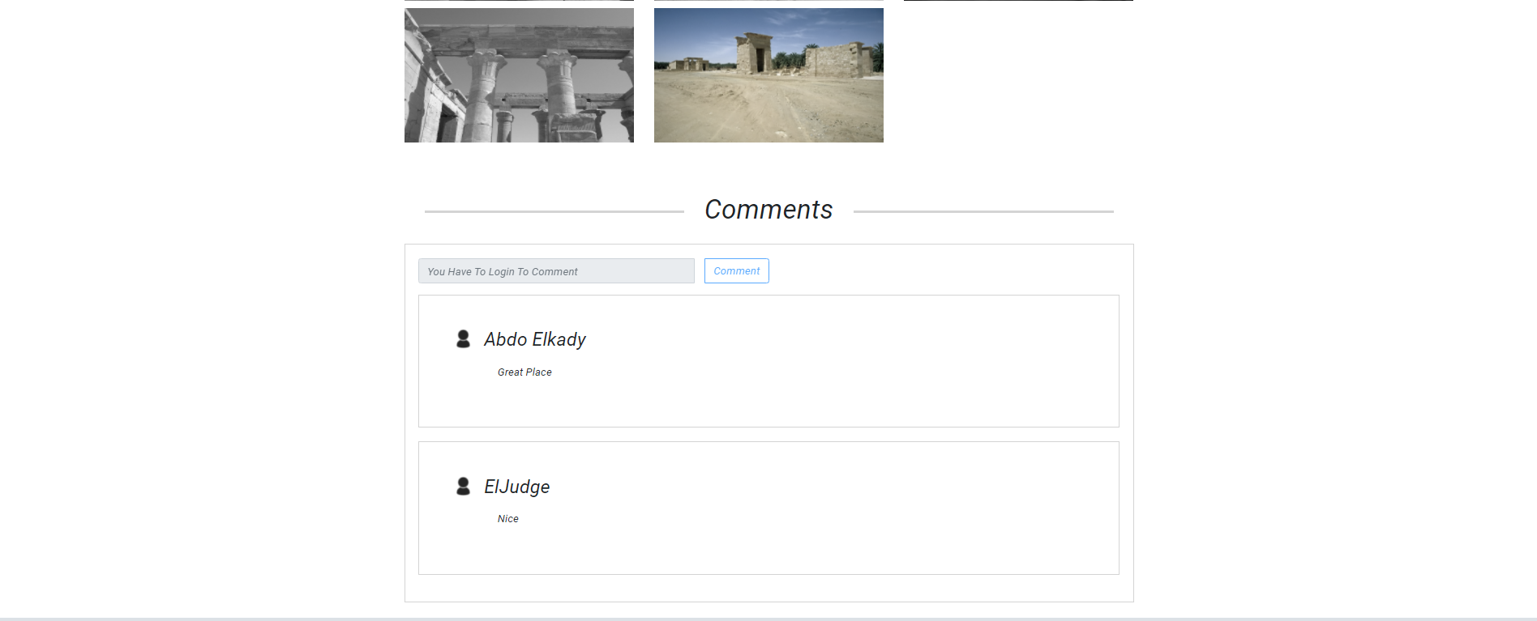

Slide 58
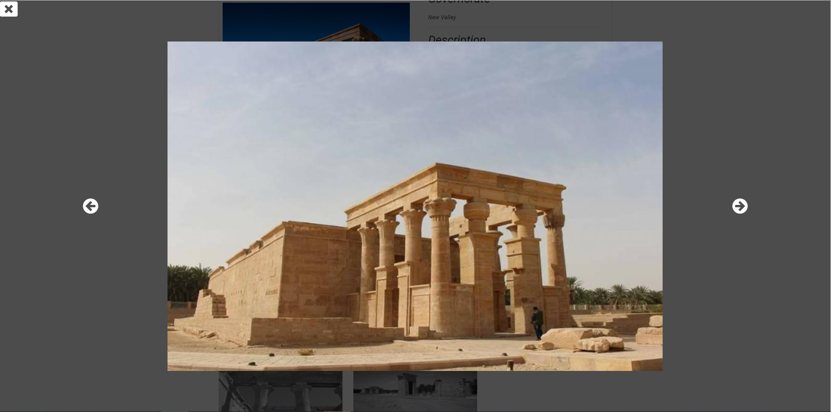

Slide 59
Search

Slide 60
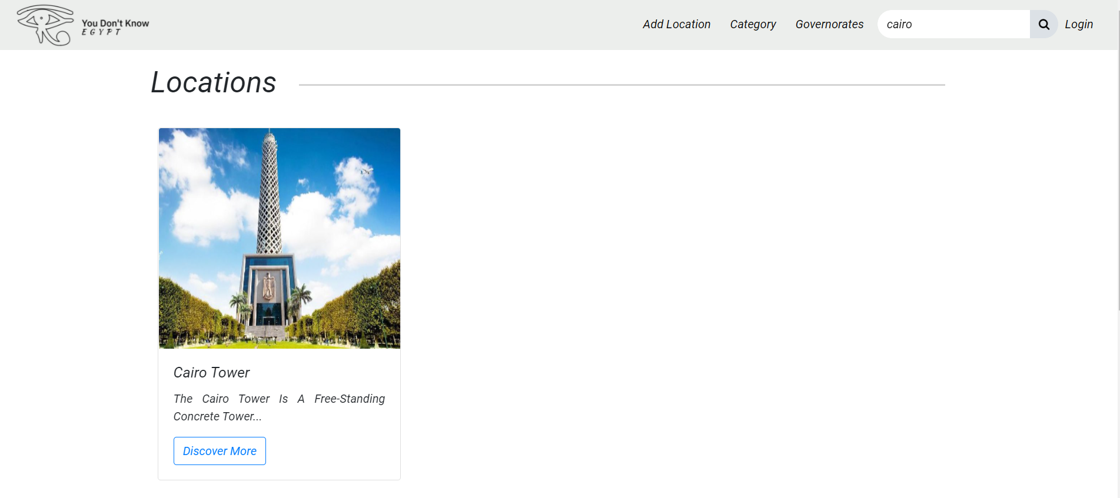

Slide 61
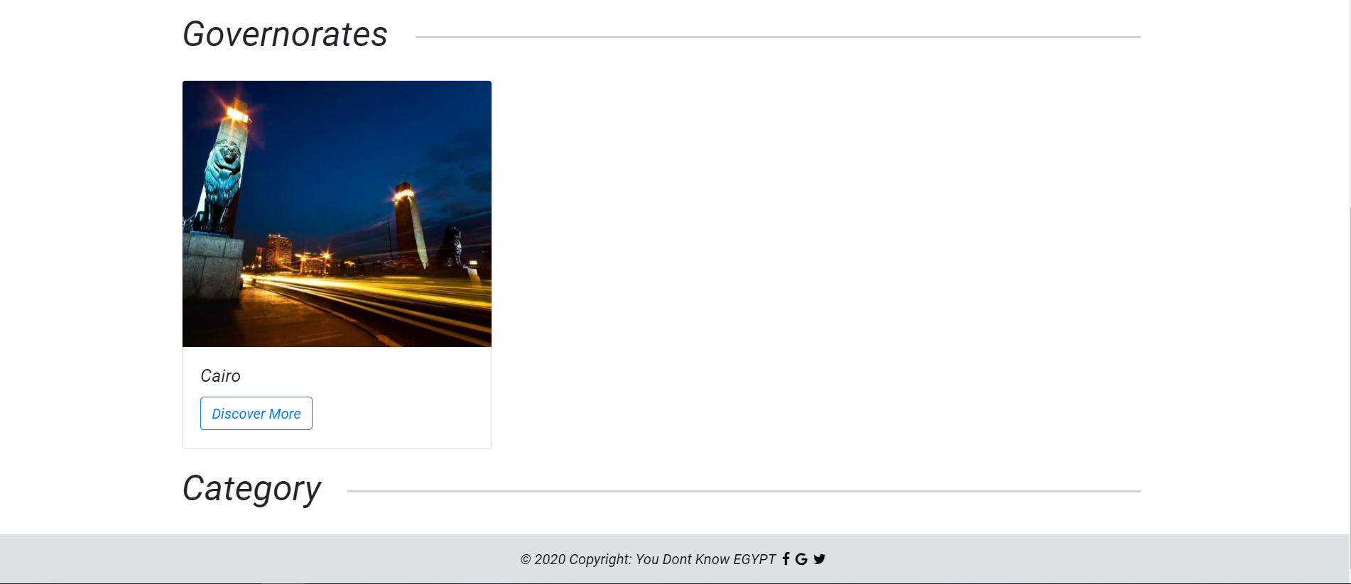

Slide 62

Admin Panel

Slide 63
Category Control

Slide 64
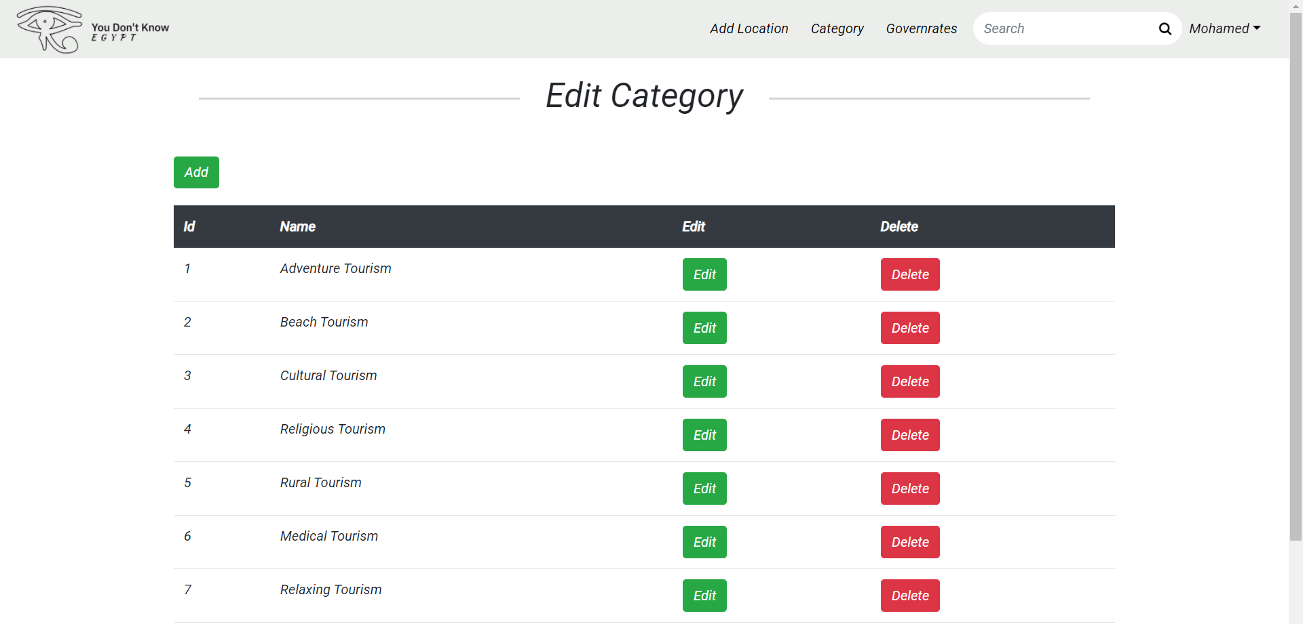

Slide 65
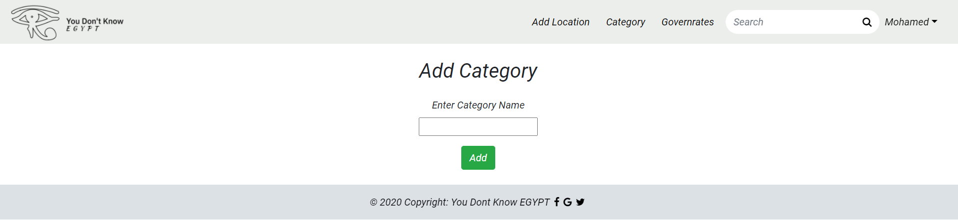

Slide 66
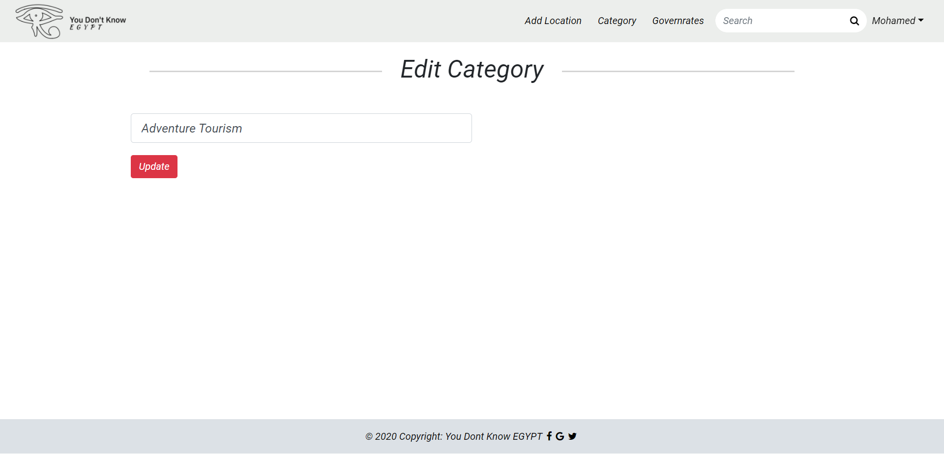

Slide 67
Governorates Control

Slide 68
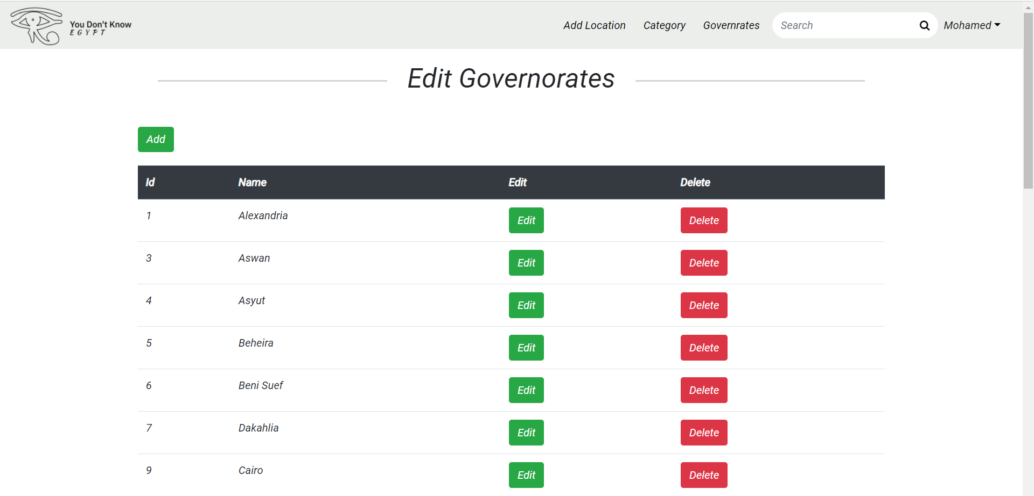

Slide 69
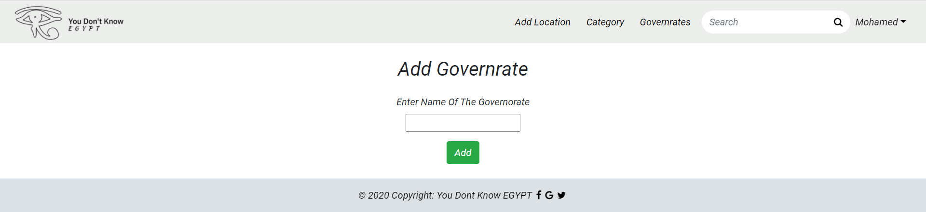

Slide 70
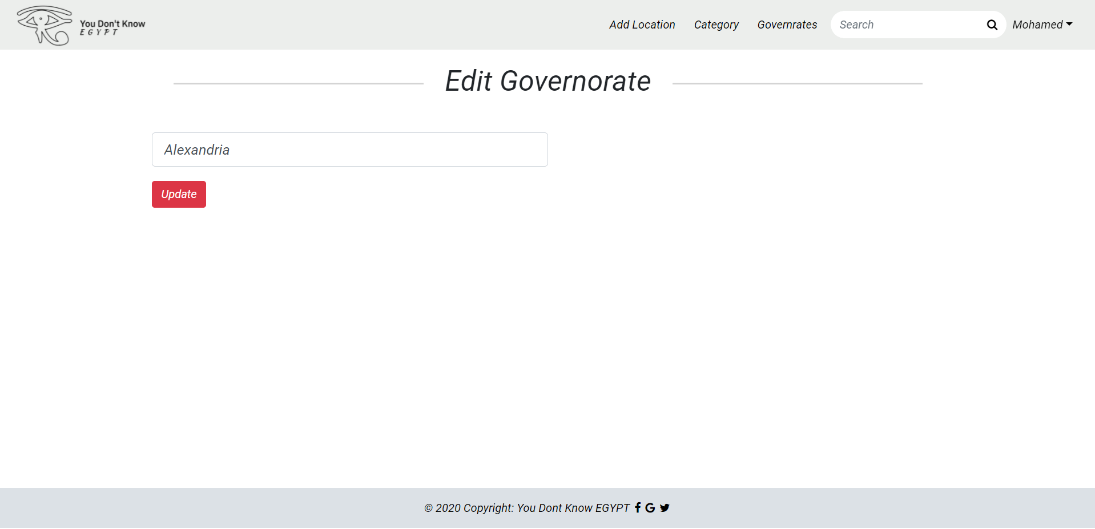

Slide 71
Approve Locations

Slide 72
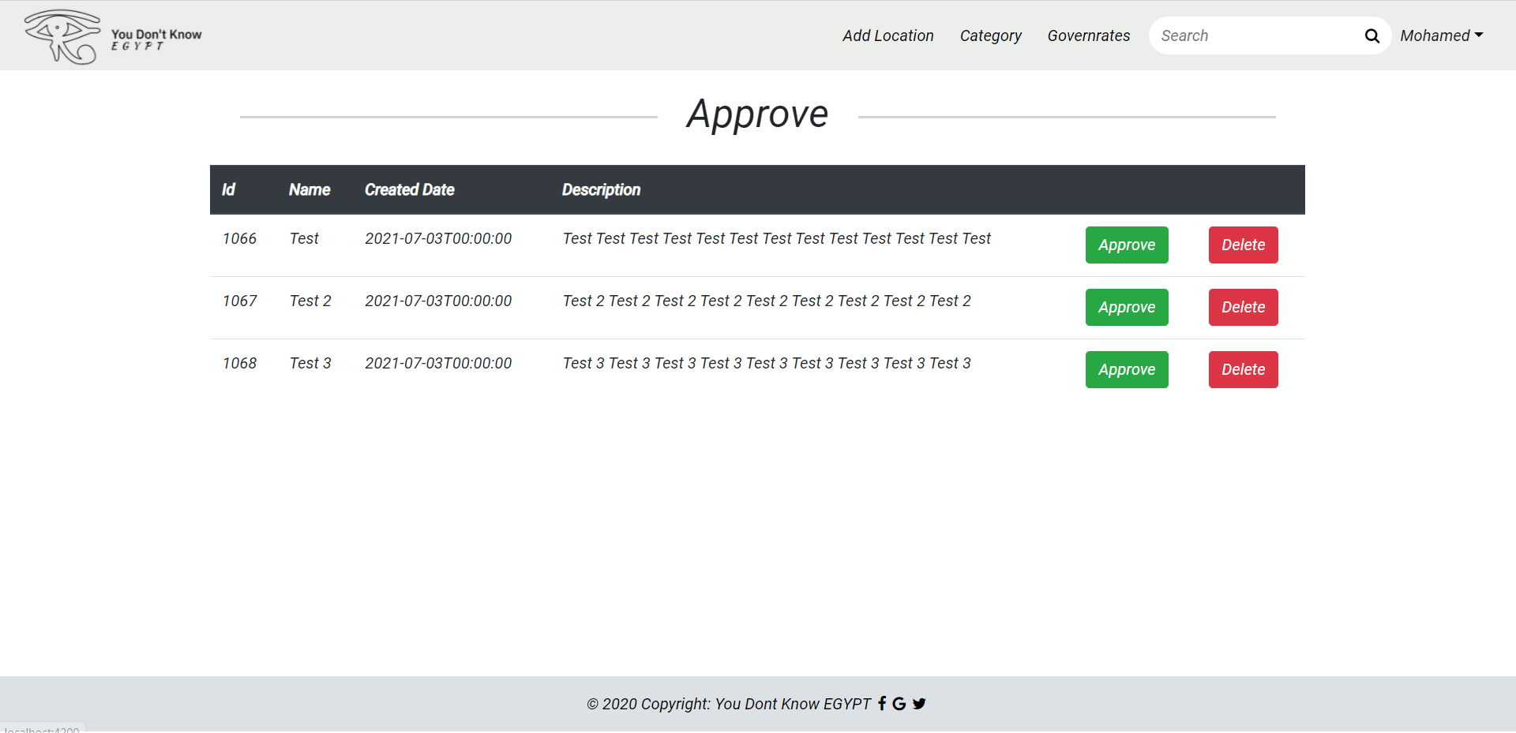

Slide 73
Security

Slide 74

Prevent SQL Injection

Slide 75
Authentication And Authorization

Slide 76

Authentication

Slide 77
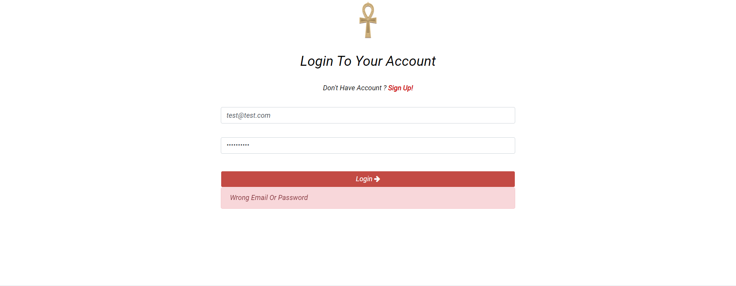

Slide 78
Encrypted Passwords On Database

Slide 79

Authorization

Slide 80


Routing Guards

Slide 81
Auth Guard

Slide 82
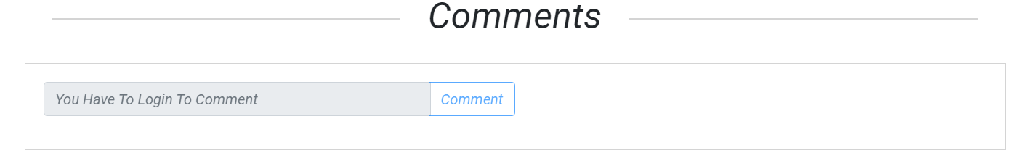
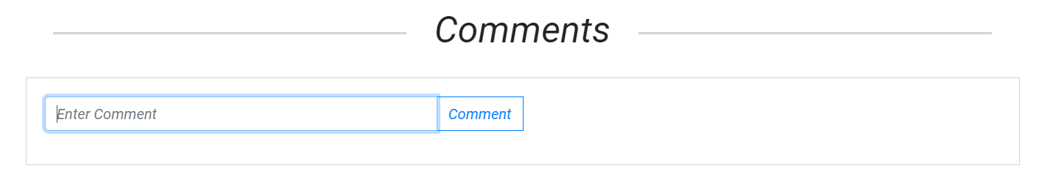

Slide 83
Admin Guard

Slide 84
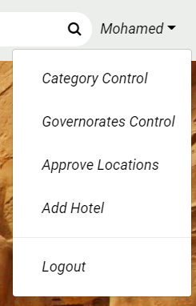
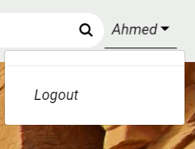
Admin
User

Slide 85
Validation

Slide 86

Front End Validation

Slide 87
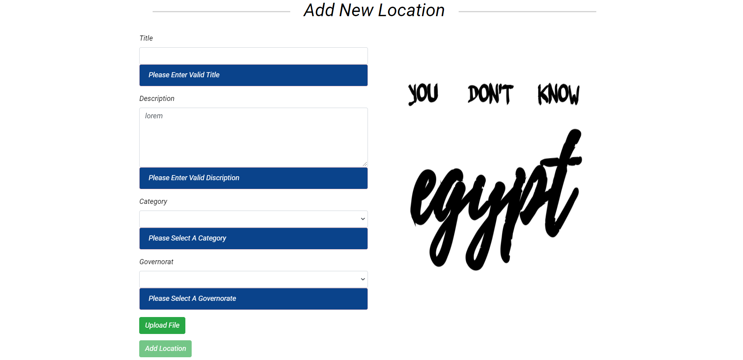

Slide 88

Database Validation

Slide 89

Back End Validation

Slide 90
API Documentation

Slide 91


Slide 92
Authentication

Slide 93
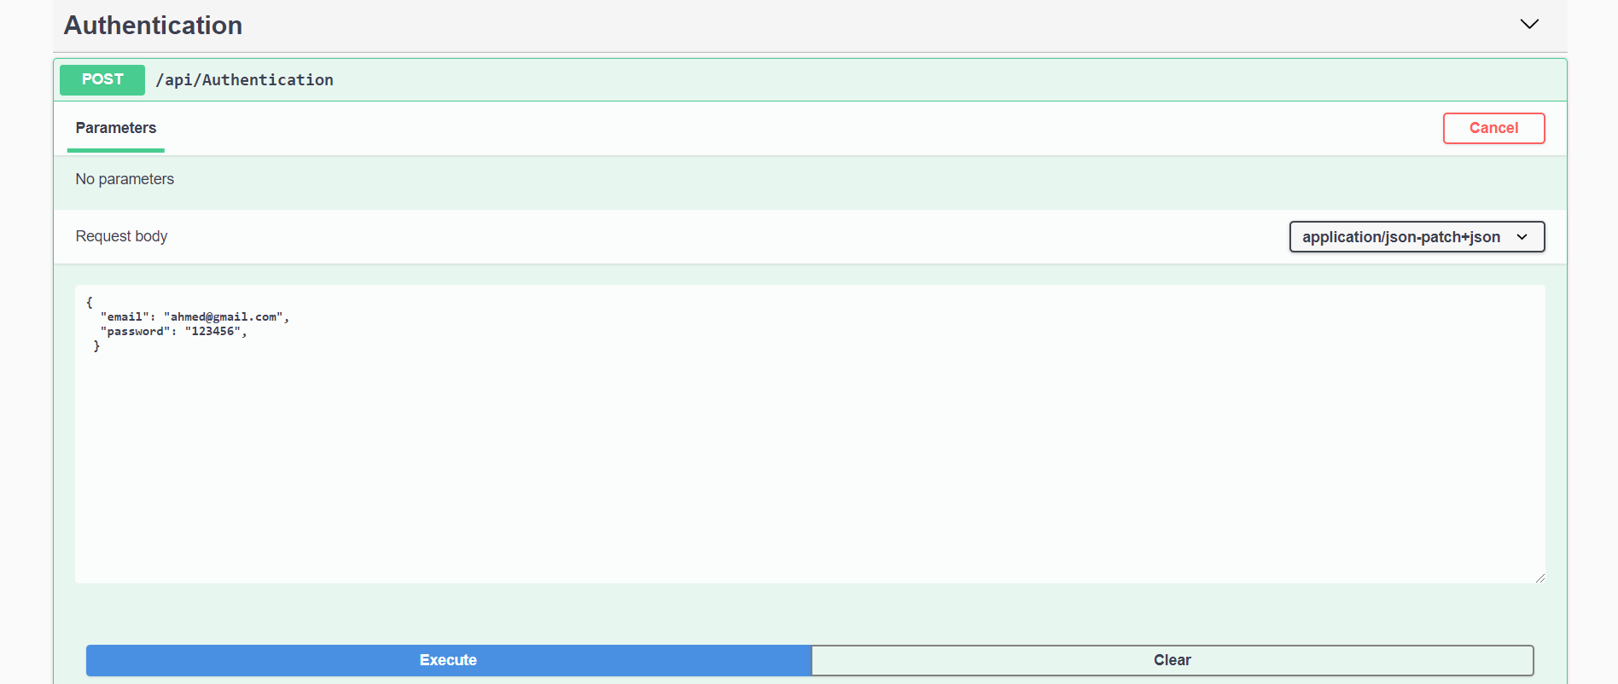

Slide 94
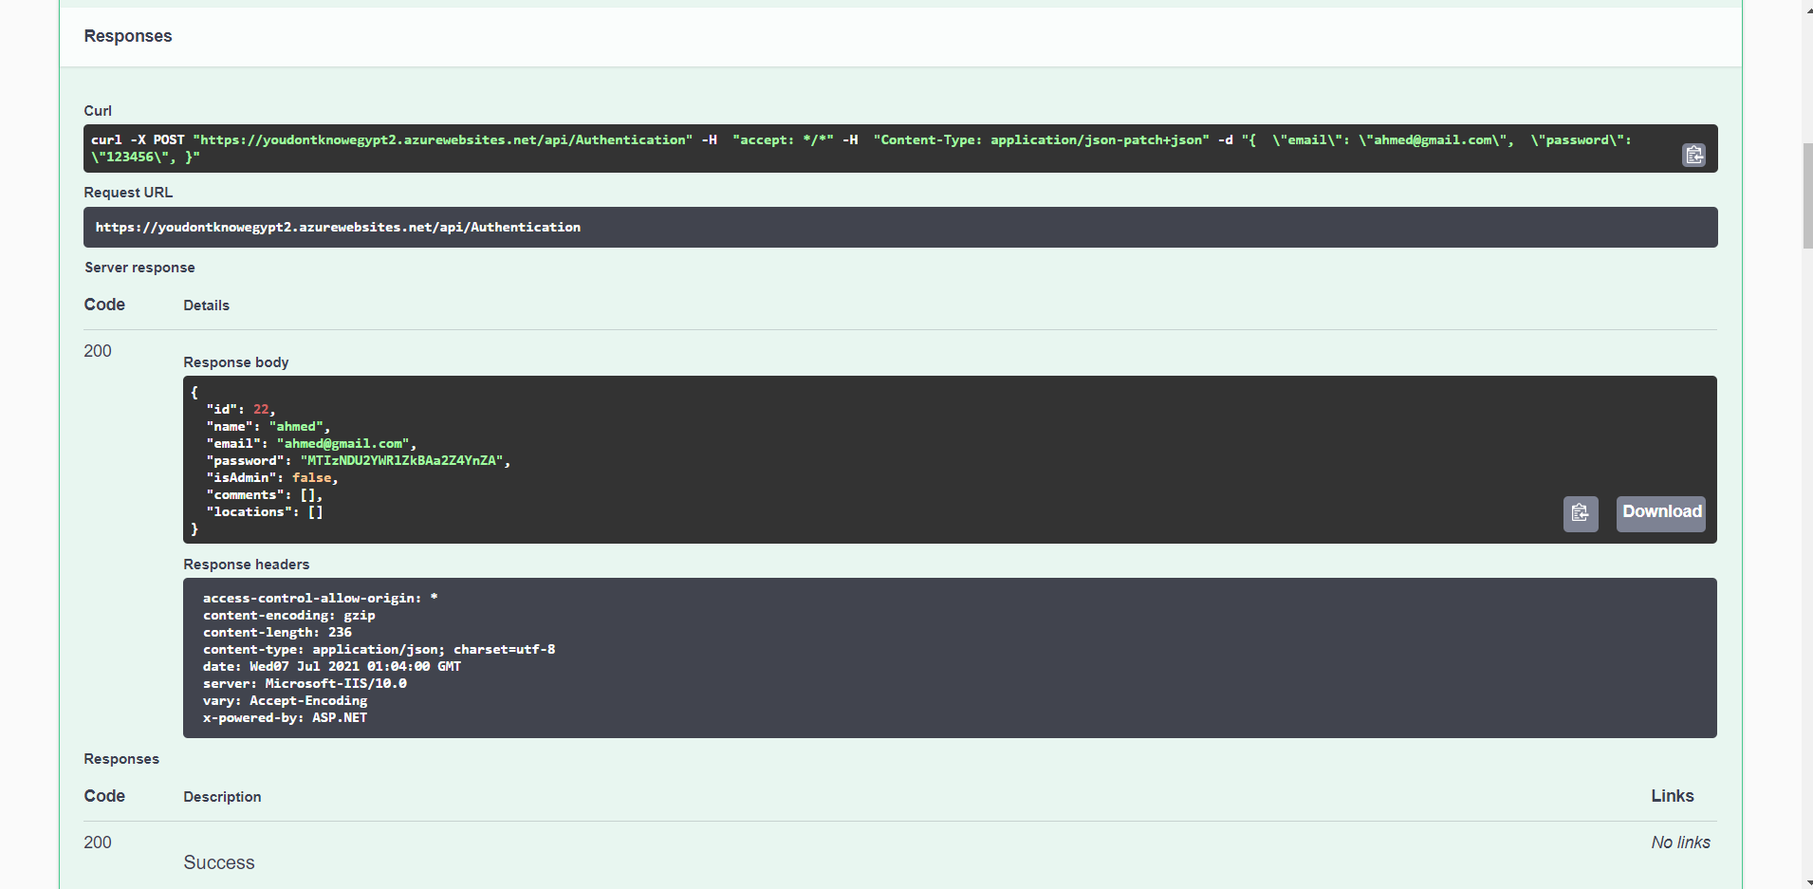

Slide 95
Categories

Slide 96
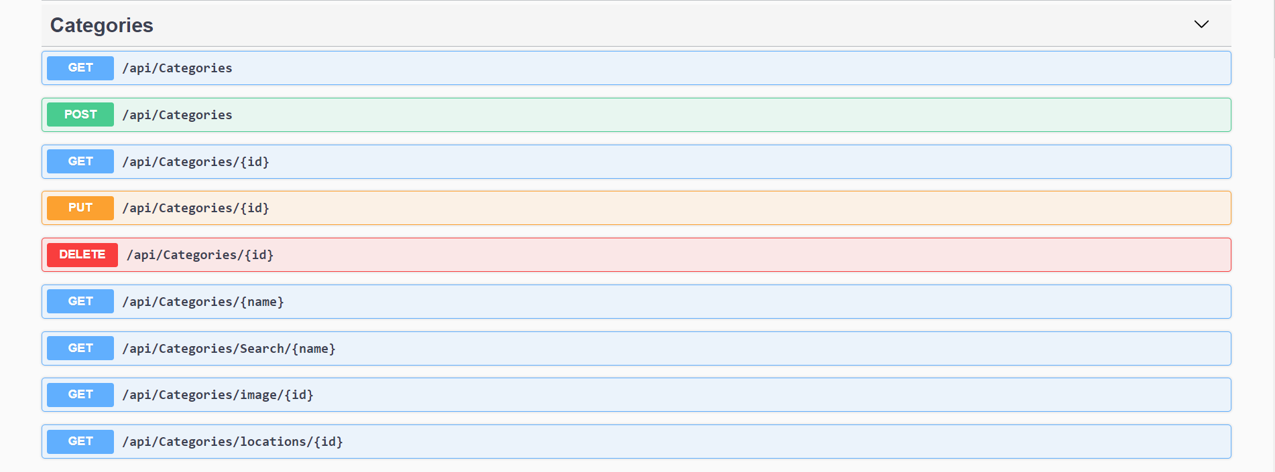

Slide 97
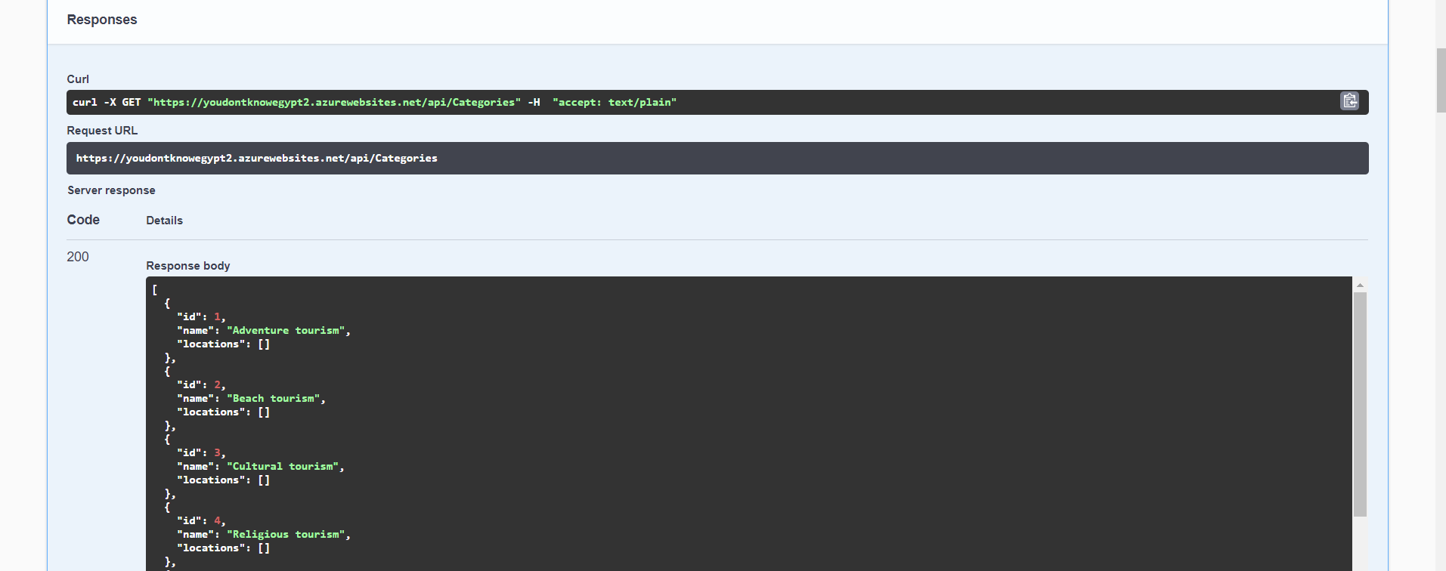

Slide 98
Comments

Slide 99
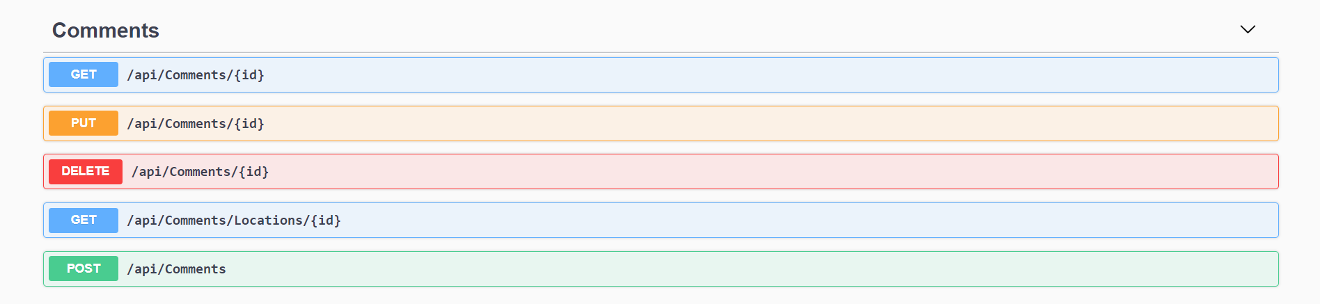

Slide 100
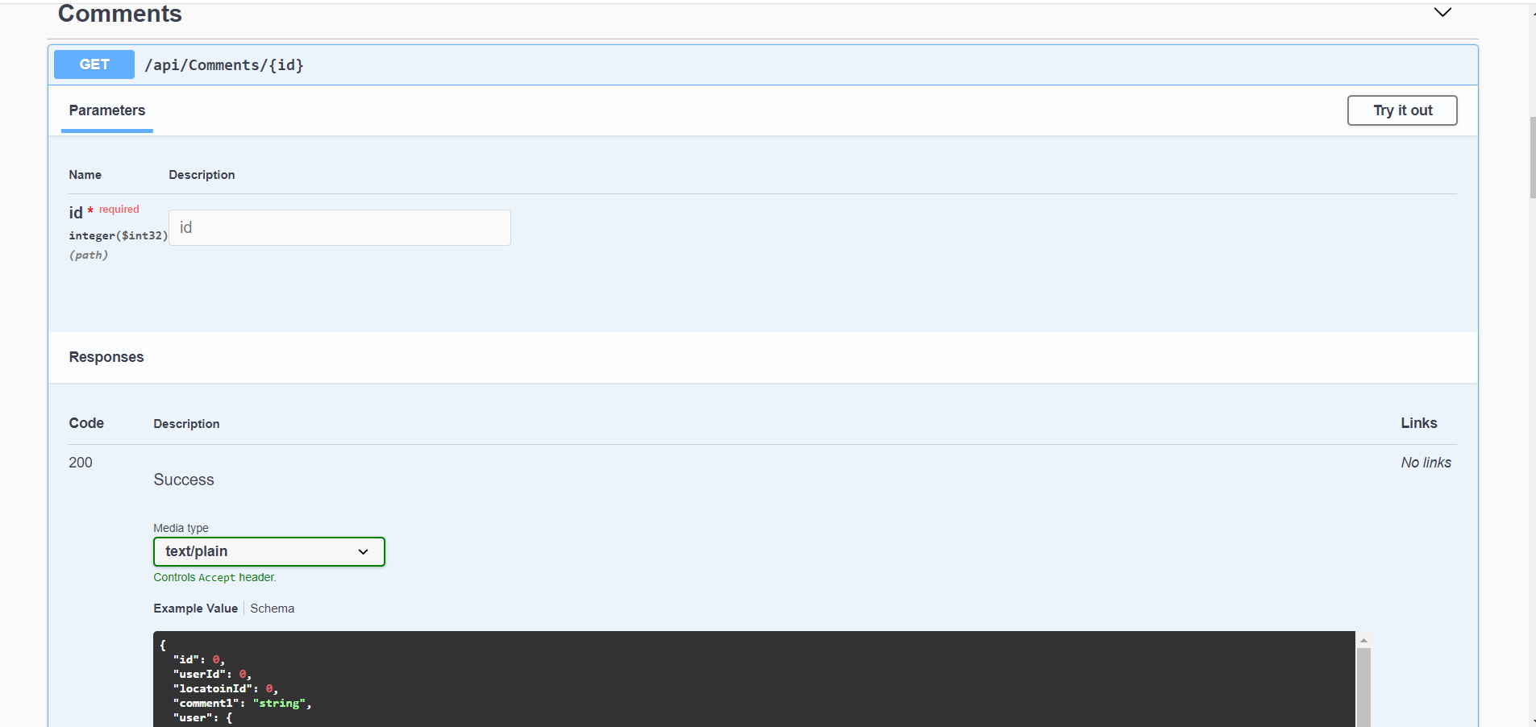

Slide 101
Governorates

Slide 102
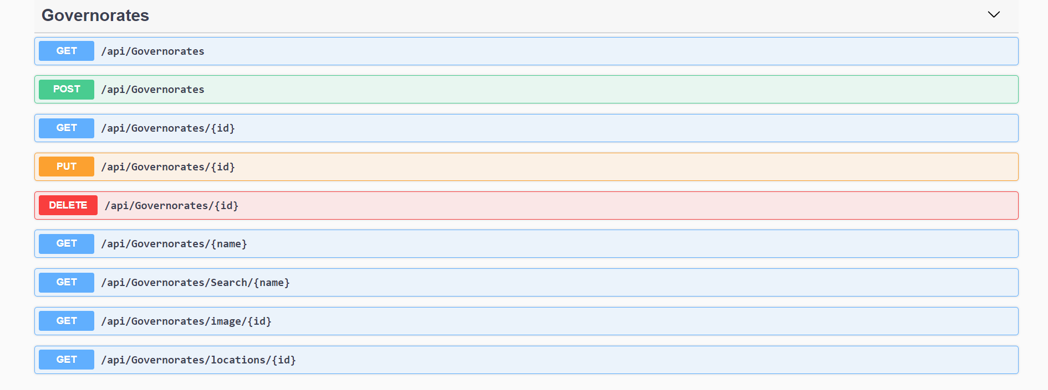

Slide 103
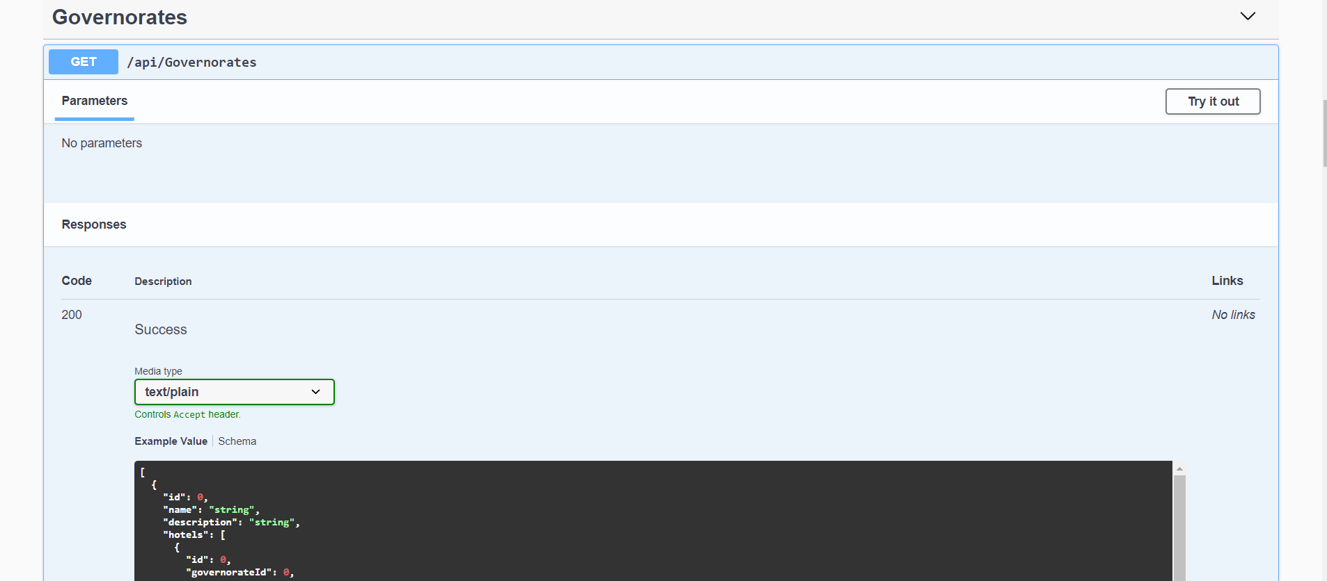

Slide 104
Hotels

Slide 105
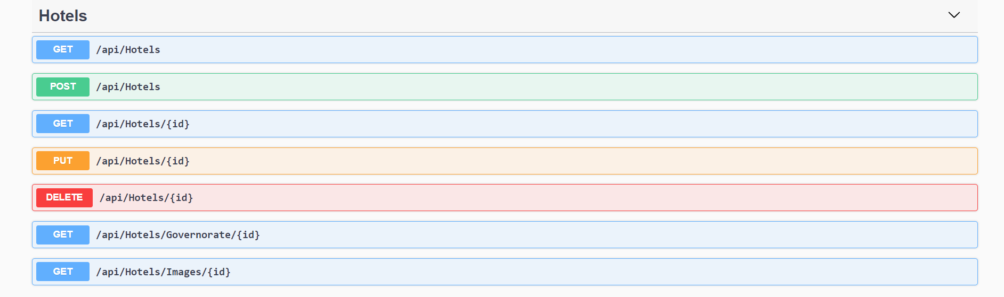

Slide 106
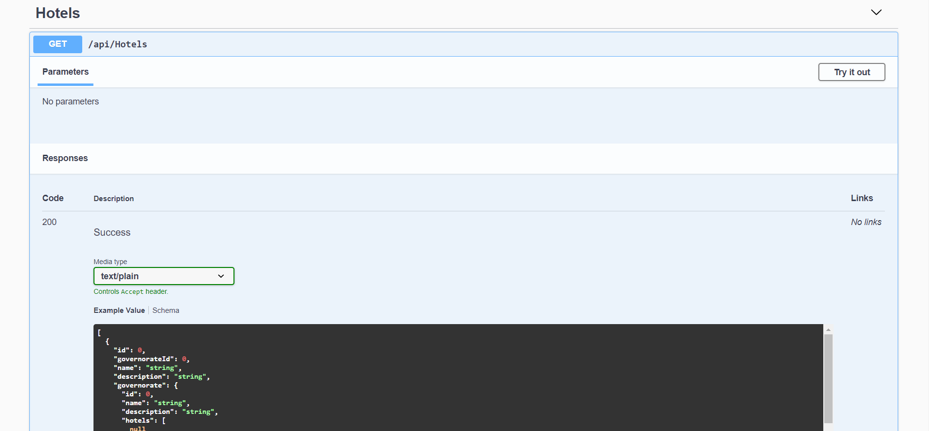

Slide 107
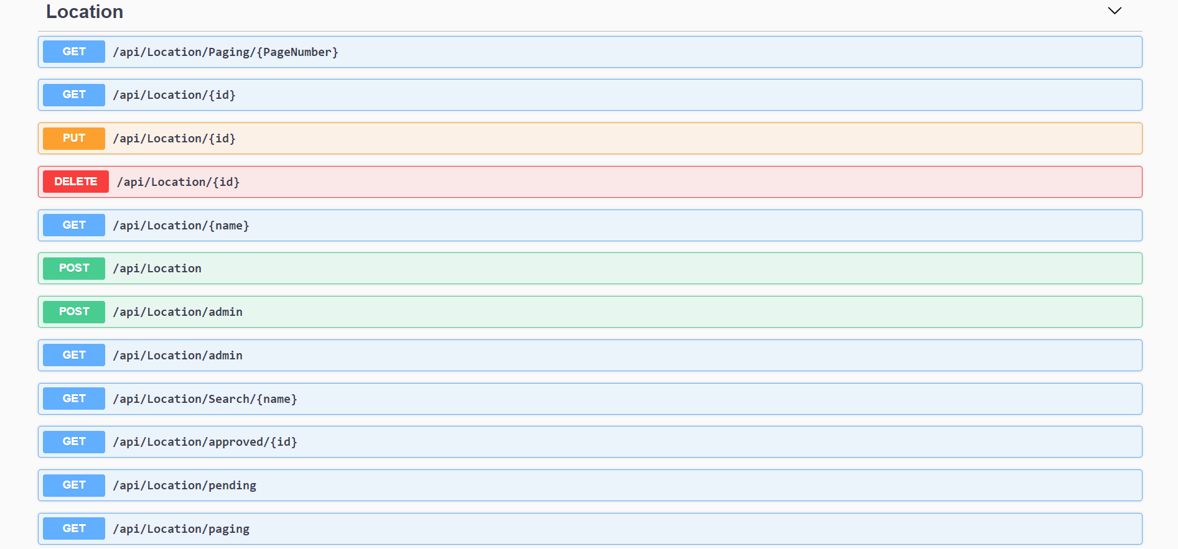

Slide 108
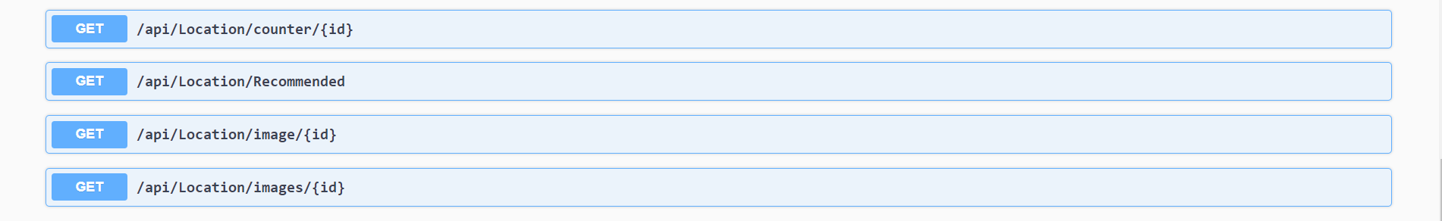

Slide 109
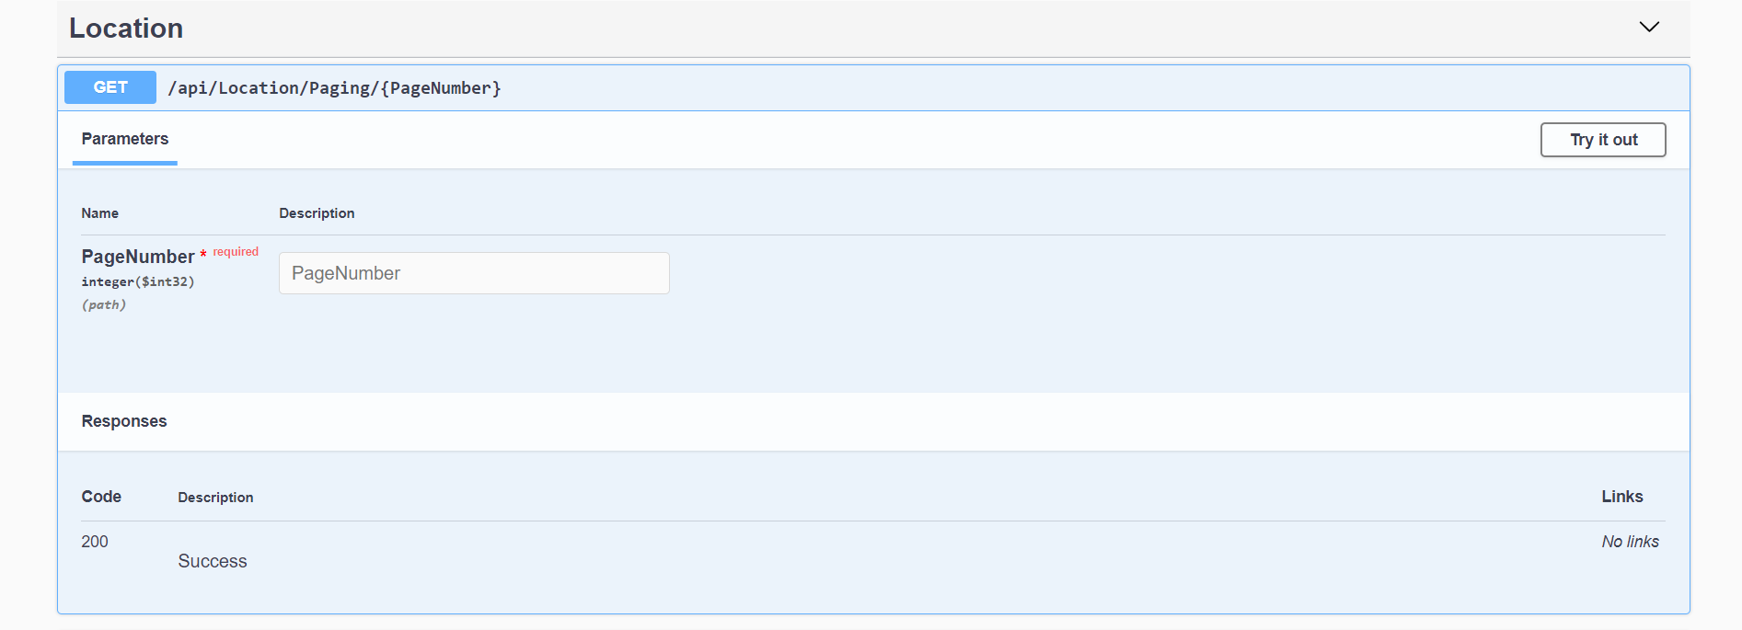

Slide 110
Upload

Slide 111


Slide 112


Slide 113
User

Slide 114


Slide 115


Slide 116


Slide 117
Database ER Diagram

Slide 119
Interfaces And Services

Slide 120
Interfaces

Slide 121
IHotel
Id:number;
Name:string;
Description:string;
Hotel_images:string[];
Governorate_id:number;
IImage
Id:number;
Location_Id:number;
Image_path:string;
Icategory
Id:number;
Name:string;
Igovernorate
Id:number;
Name:string;
Description:string;
ILocation
Id:number;
Approve:Boolean;
Category_id:number;
Description:string;
Governorate_id:number;
Name:string;
User_id:id;
Icomment
Id:number;
Comment:string;
User_Id:number;
Location_Id:string;
IHotelImages
Id:number;
Hotel_Id:number;
Image_path:string;
IUser
Id:number;
Name:string;
Email:string;
Password:string;
IsAdmin:Boolean;

Slide 122
Services

Slide 123
CategoryService
Angular Components
LocationService
CommentService
HotelService
GovernorateService
SearchService

Slide 124
AddLocationComponent
AuthGaurdService
UserService
SignUpComponent
LoginComponent
AuthService
AdminService
AdminComponent
AdminAuthGaurdService

Slide 125
Http Request
Front End
Component
Front End
Services
Web API
SQL Server
Database
Http Response

Slide 126
System Deployment

Slide 127

Front End On Firebase

Slide 128

Back End APIs On Azure

Slide 129

Database on FreeAspHosting

Slide 130
Future Work

Slide 131



Login With Facebook, Google and Email

Slide 132

Google Maps

Slide 133

Rating Locations And Hotels

Slide 134

Multilingual

Slide 135
Restaurant

